Slide 1
Analysis of the Potential of the TimeTube for SBL Neutrino Measurements
John Learned
University of Hawaii, Physics and Atronomy

Slide 2
Purpose
Make study of the geometry of a square light guide with LS to understand potential for a 3D few MeV neutrino detector (aimed at IBD).
Principle study goal to see if lateral resolution is possible.
Tentative conclusion: Sadly, it is not.
But, many interesting things about square tube optics, and implications for way forward.

Slide 3
Assumptions (for study)
Square tube about 1 meter long, and 10-15 cm wide (used 128mm herein).
Liquid scintillator fill, doped with 6Li for neutrons, 5m optical attenuation.
Assume n_{ls} = 1.58, n_{wall} = 1.24
Perfect geometry, infinitely fast LS, point light source of 3 MeV.
1 mm x 1 mm pixel detector covering end planes

Slide 4
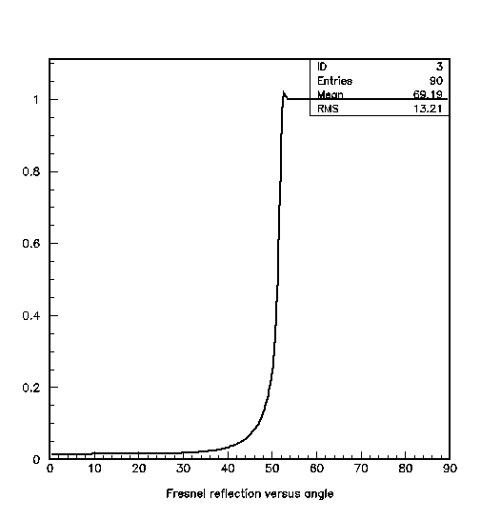
Light propagates down tube, largely by total internal refelection
Graph shows reflectivity versus angle from the normal to the surface. TIR for rays closer than 38º to tangent.
Uses Fresnel equations for unpolarized light.

Slide 5
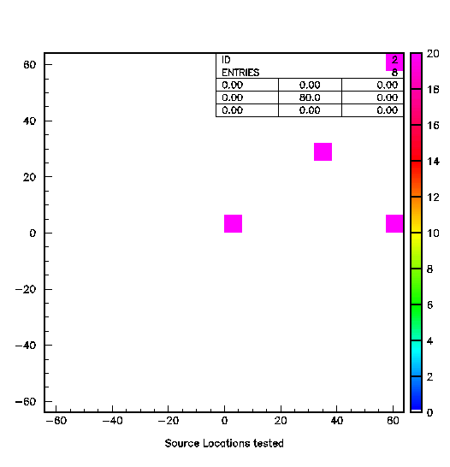
Trial Source locations
Four locations:
1) Corner
2) Half way towards center
3) Center
4) Right hand edge
All sources start at 15 cm from mid-plane (65 cm to far end, 35 cm to near end)
8 illustrative runs.
1
2
3
4

Slide 6
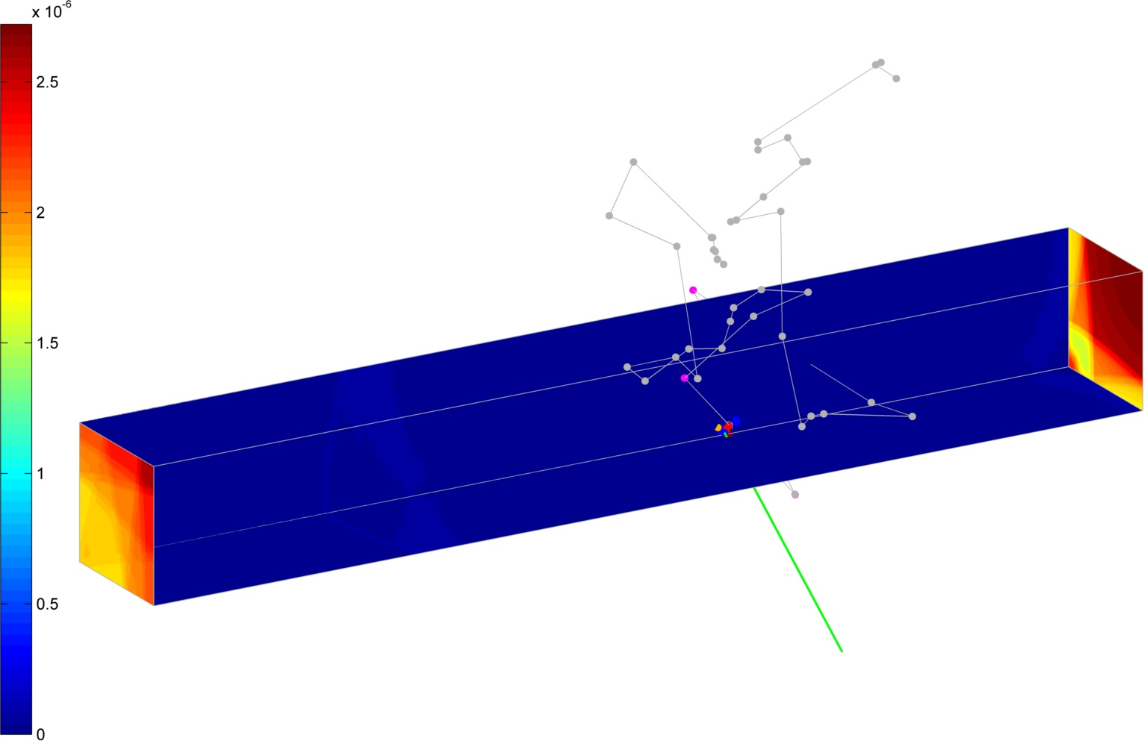
Point 1

Slide 7
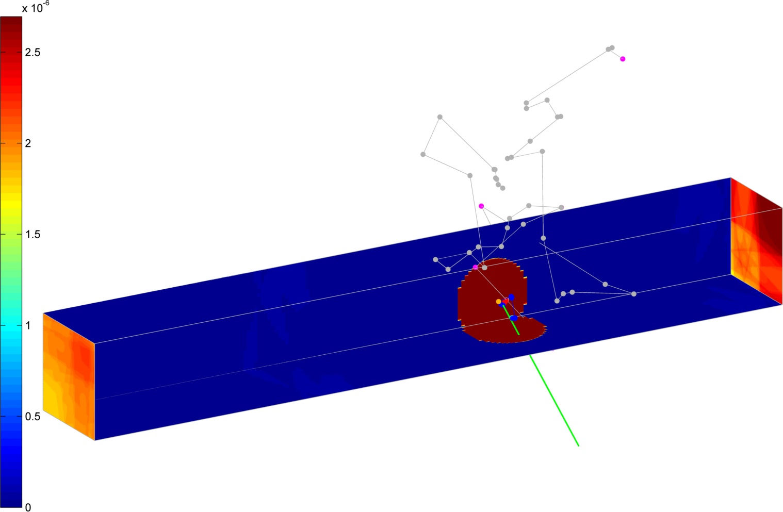
Point 2

Slide 8
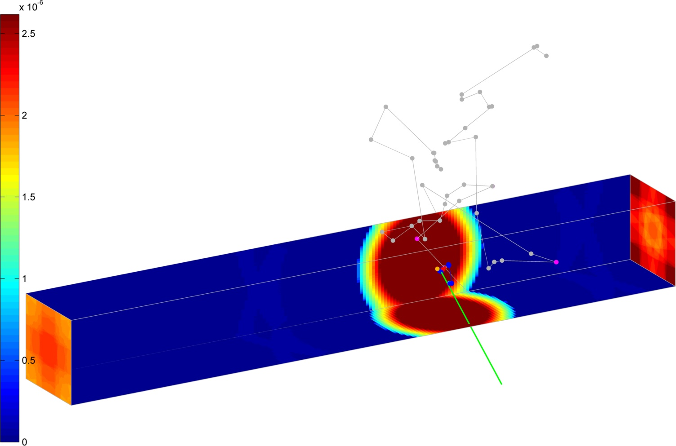
Point 3

Slide 9
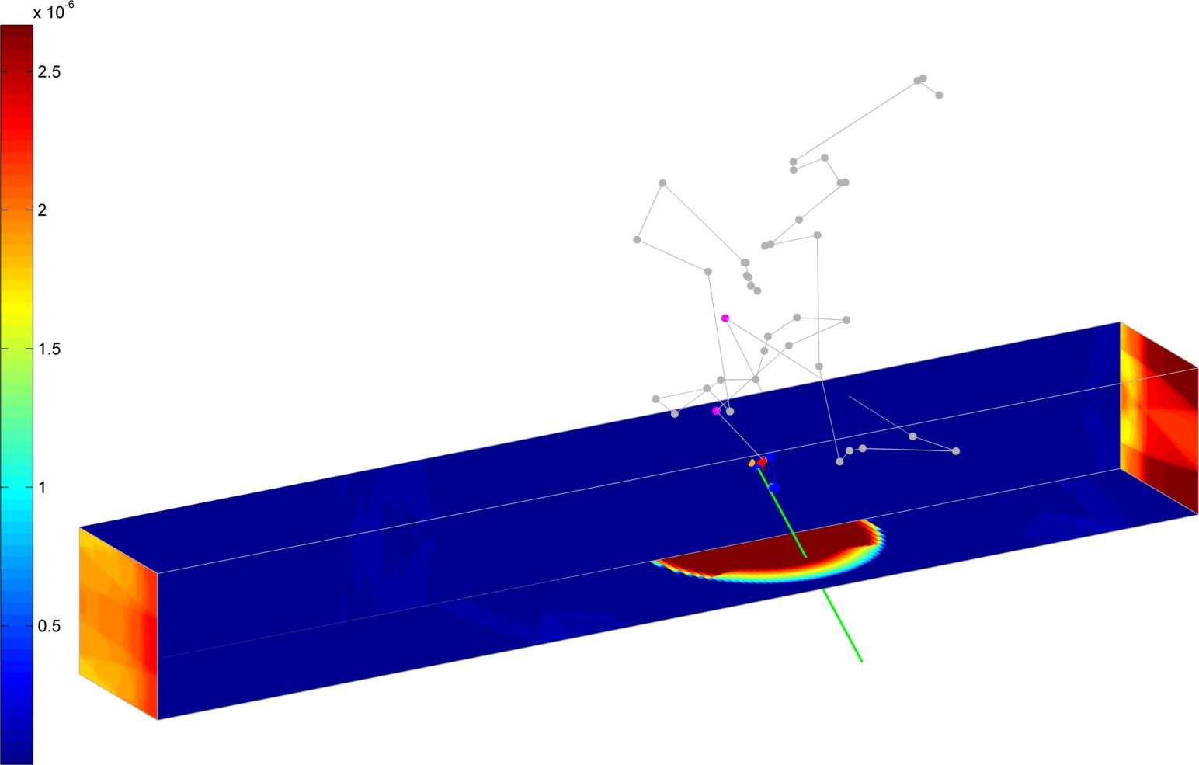
Point 4

Slide 10
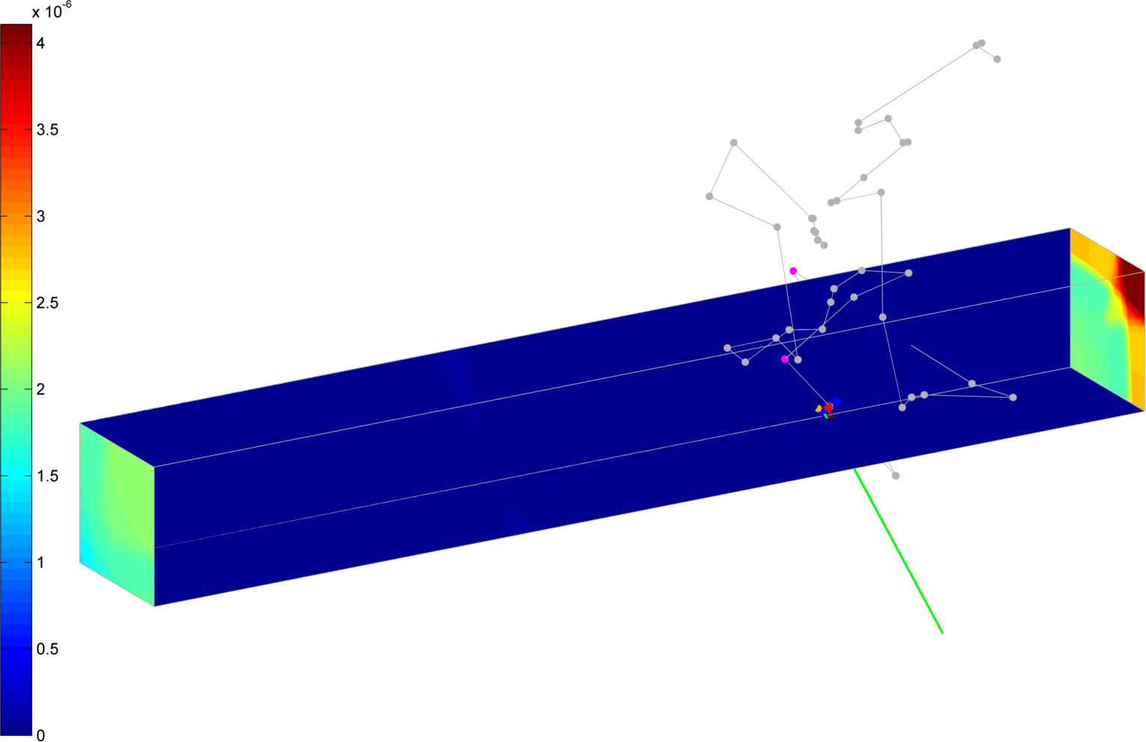
Point 1, ¼ length from face

Slide 11
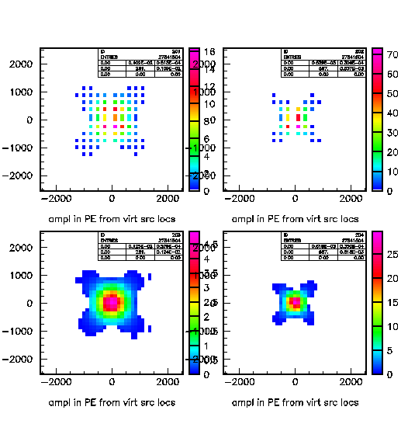
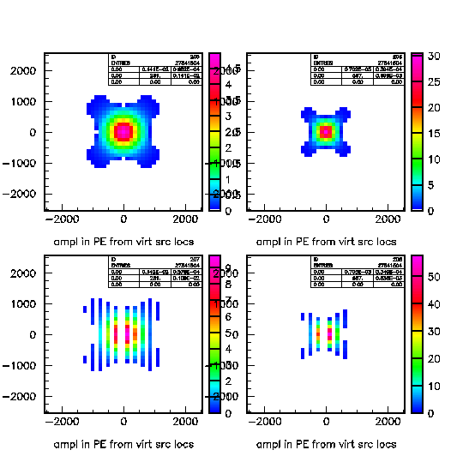
Virtual Source Patterns, Including Reflections
Illustrates the kaleidoscope nature of the image.
5m light attenuation in LS
Reflections go out to virtually 1.2m! And 5 or 6 reflections.
Strong diagonal trend.
Same pattern of plots in all following slides.
Upper right corner
Center
1 Far
1 Near
3 Far
3 Near
2 Far
2 Near
4 Far
4 Near
Halfway on diagonal
Middle Right Side

Slide 12
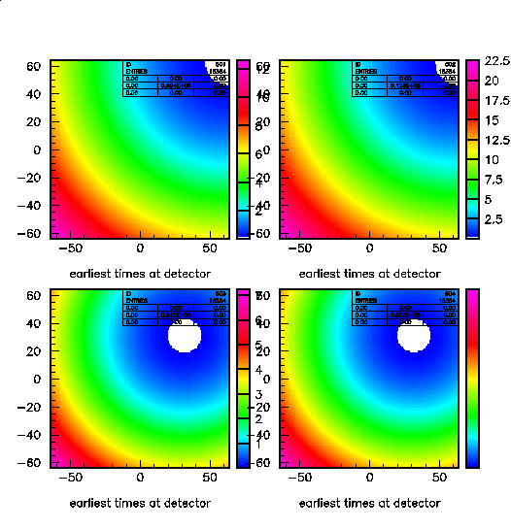
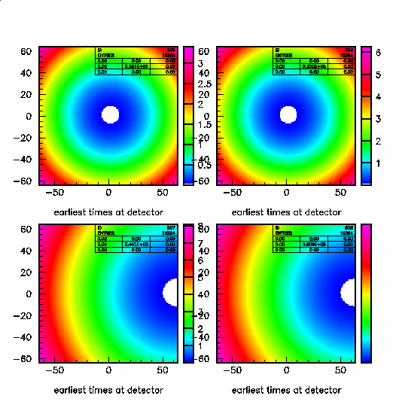
Light Arrival Times at Image Plane
First photon times in picoseconds from first time on the detector plane.
One clearly sees the origin image location.
But time difference is tiny: 6-20 ps.

Slide 13
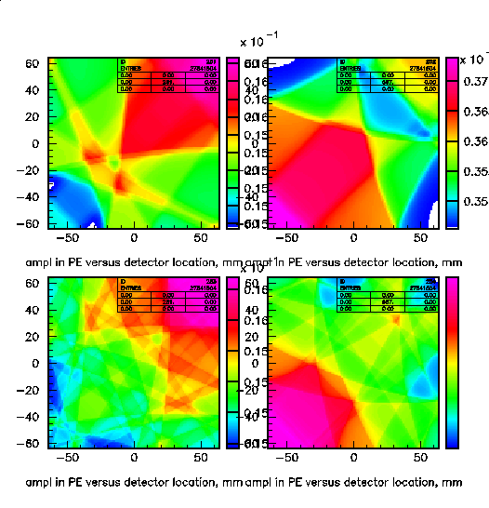
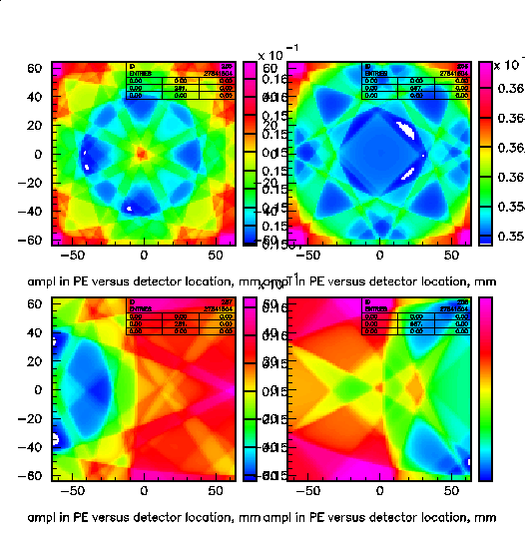
PE Distribution in Image Plane
Wild Kaleidocscope patterns, hinting at source location.
But I do not see how to process.
In any event, contrast ratio is ~3%
Suggest some sort of transform may reveal source.

Slide 14
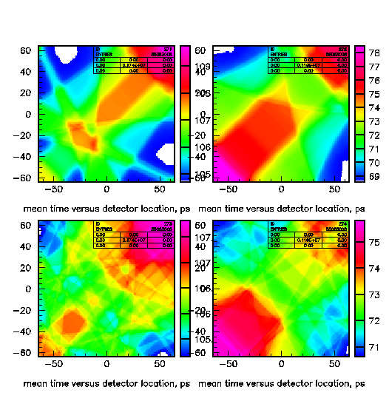
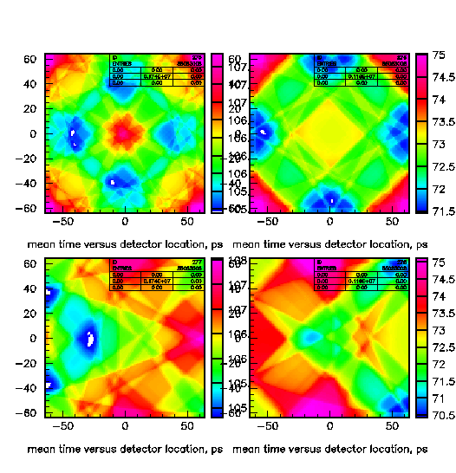
Another Attempt: Mean Times in Image Plane
Similarly suggestive patterns.
Note using only ideal times, not scintillator smeared times.

Slide 15
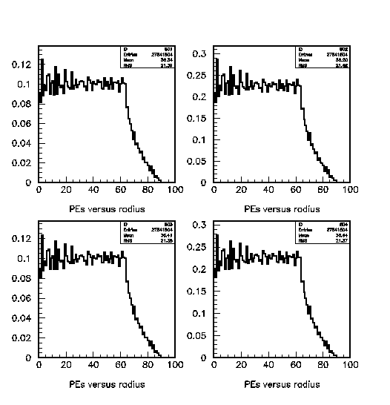
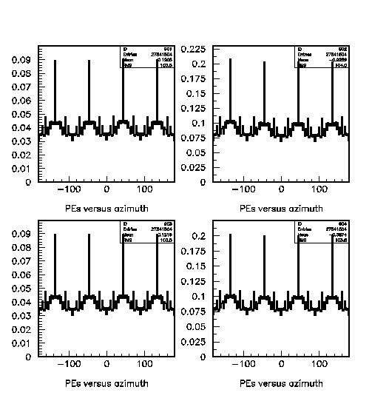
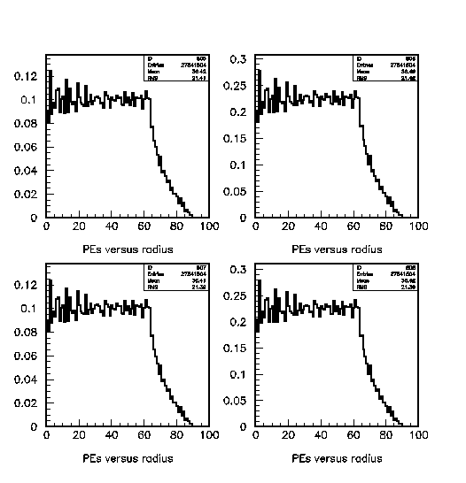
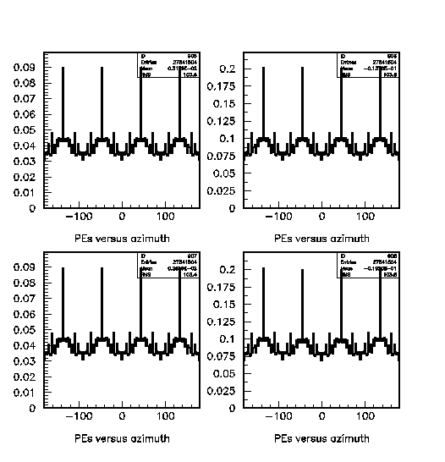
Radial and Azimuthal hit distributions
Radial distribution weighted with radius
Consistent with a uniform illumination, independent of source location!
Azimuthal distributions (also r weighted) show sharp peaks along diagonals. Shows crab eye nature of square tube. No hint of source location.

Slide 16
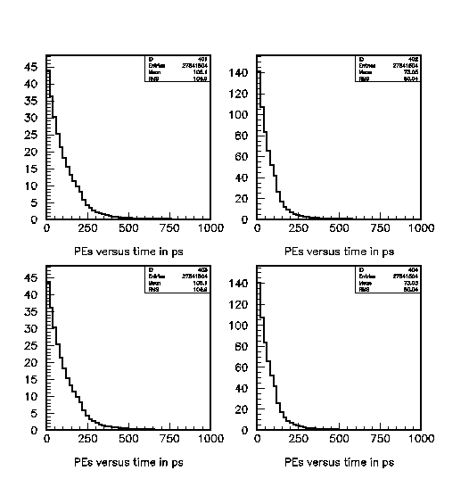
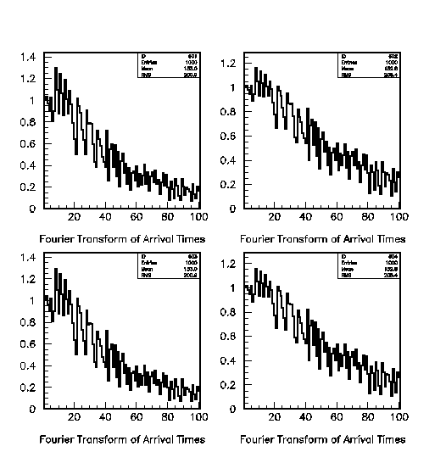
Idealized Time Distributions
Sample times of arrivals do show dependence on source longitudinal location (comepare far and near).
But at ~200 ps level with no scintillator smearing.
FFTs of arrival times show nothing interesting.

Slide 17
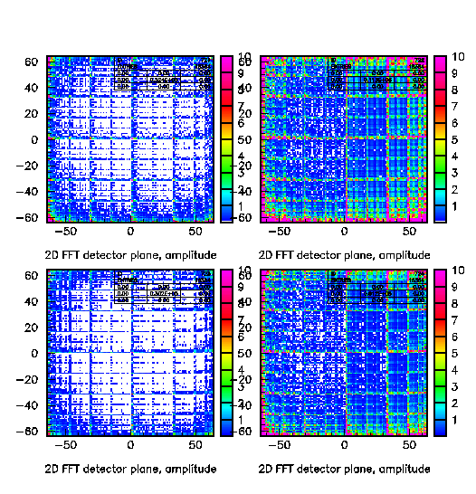
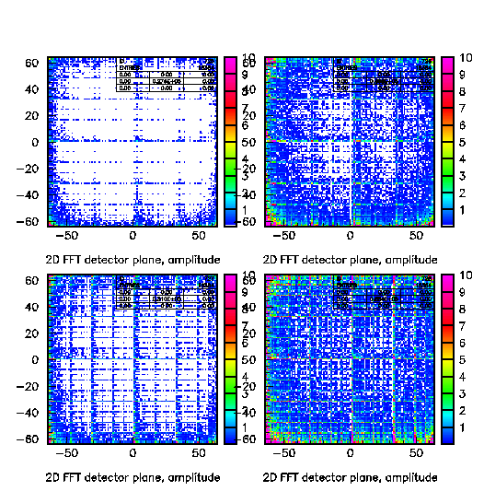
Spatial Fourier Transforms of Hit Pattern on Image Plane
Units are meaningless, x and y frequencies, lower left being ~zero and upper right pixel wavelength.
One sees harmonics of the scale width.
I do not see what to make of this, do you?

Slide 18
Conclusions
The TimeTube fails to meet my initial enthusiasm for yielding lateral source resolution, even under ideal presumptions.
The longitudinal resolution should be fine, and with reasonable scintillator, fast <ns detectors and electronics, good to a mm or so.
The overall collected light in such a square tube is wonderfully uniform on the image plane independent of source transverse location.
The virtual (kaleidoscope-like) images have a strong diagonal nature.
Positron track resolution seems doubtful.

Slide 19
Bigger Picture Implications
If we want reactor detector with good (mm) spatial resolution (mostly for background rejection), the easier route may be segmentation of tubes… DANNS like. Long square tubes of 1-3 cm width.
I further note that this would be a poor application for LAPPD detectors. Darn.
mTC-like resolution will not be possible in this geometry…. Back to cubes or ?

Slide 20
Extra Slides

Slide 21
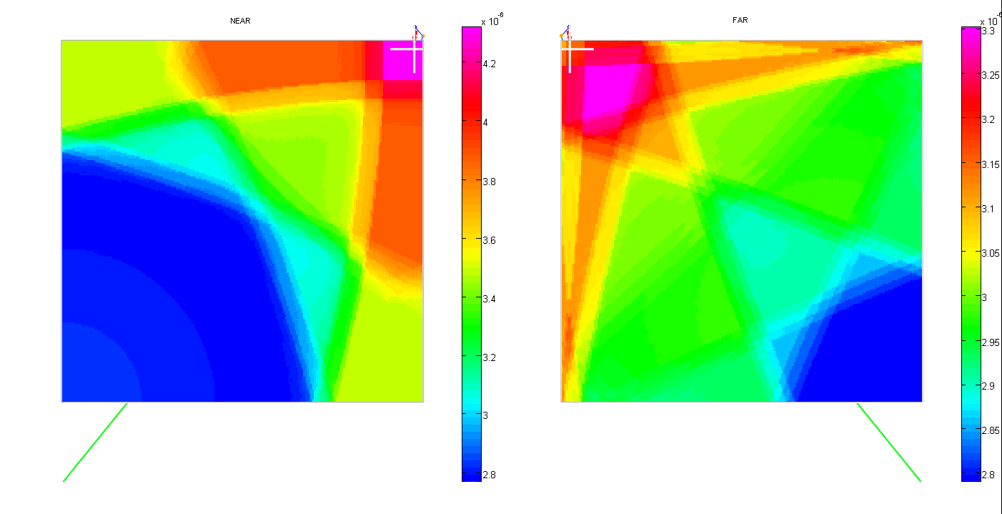
Point 1 pdf (corner)

Slide 22
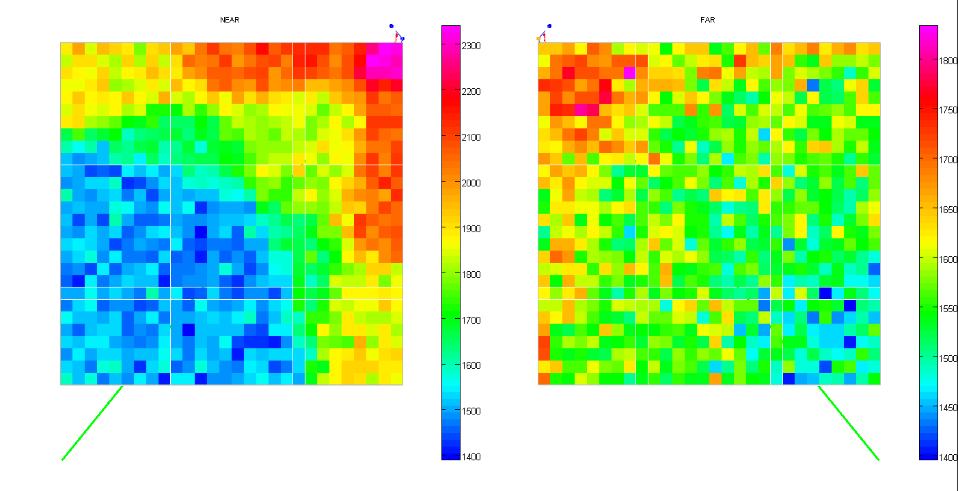
Point 1 MC (corner)

Slide 23
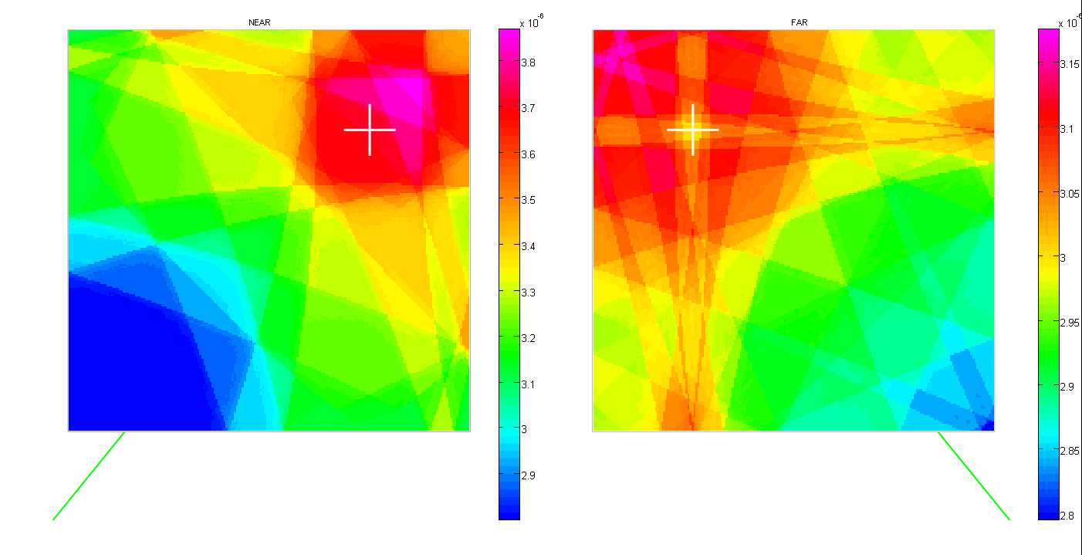
Point 2 pdf (halfway to corner)

Slide 24
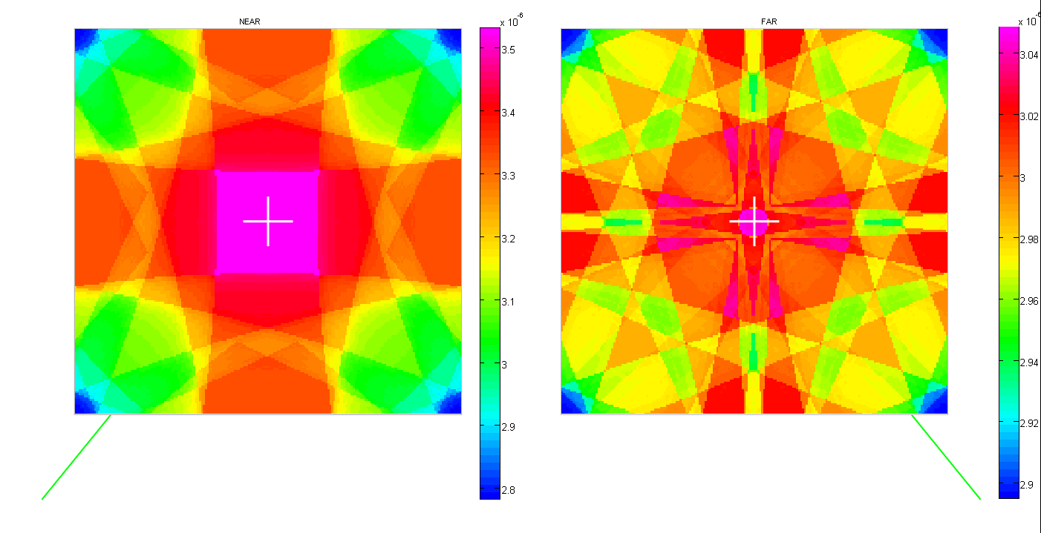
Point 3 pdf (center)

Slide 25
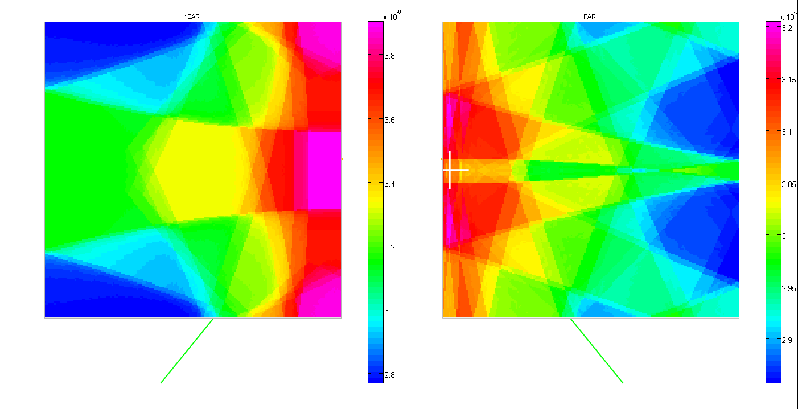
Point 4 pdf (center wall)

Slide 26
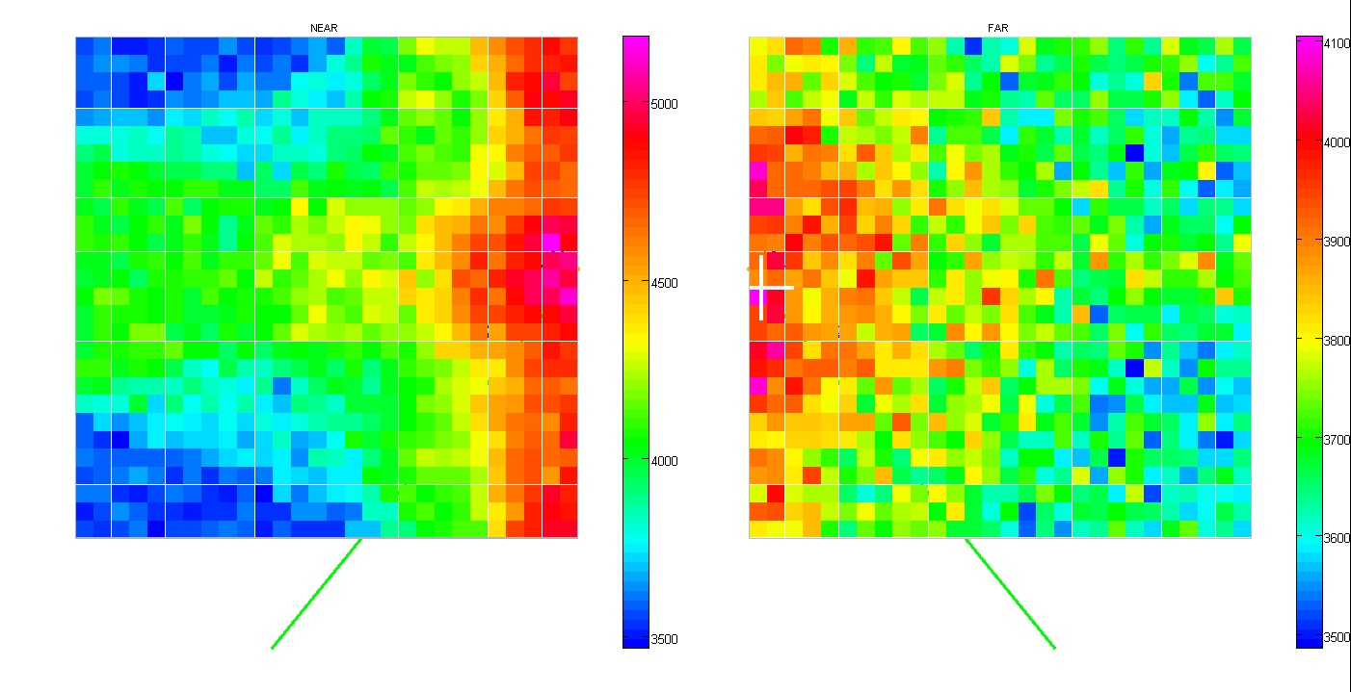
Point 4 MC (center wall)

Slide 27
ALL 4 comparison slide (Jocher)
corner
center
halfway to corner
center wall

